Slide 1


Slide 2

The Problem

Slide 3
1
3
Of Laptop owners continue to take notes by hand

Slide 4
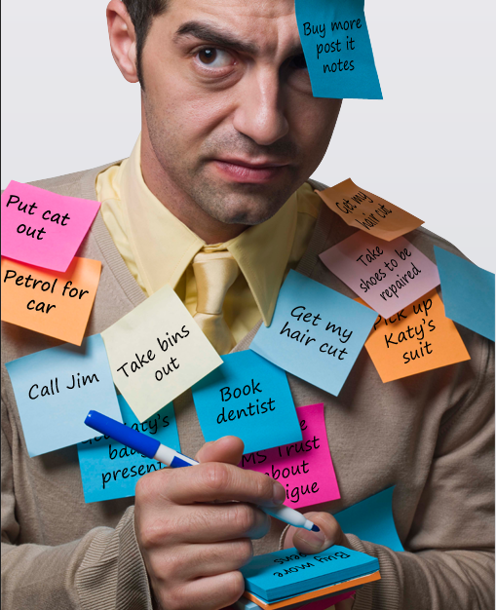

The problem with handwritten notes
“I can’t FIND them”
Cephas Tan
“There isn’t a BACKSPACE button”
Marcus Koe
“I can’t find
them.”

Slide 5







C U R R E N T
S O L U T I O N
S

Slide 6

Inconvenient Typing
“I switched back to taking notes by hand because changing colors were a hassle.”
- Evan Ma

Slide 7


Ineffective information retrieval
5
7
Interviewees have experienced difficulty in retrieving information

Slide 8

Lack of collaborative features
“I can’t figure out who wrote what”
Nicholas Siew
“It sucks when someone changes your part without you knowing”
- Cephas Tan

Slide 9
Inconvenient typing?
Can’t find information?
We offer shortcut binding
We support note Querying
The Solution?
We distinguish authorship clearly
We provide content based permissions
Who wrote what?
Who changed my part?

Slide 11


Author
Search
Date

Slide 12
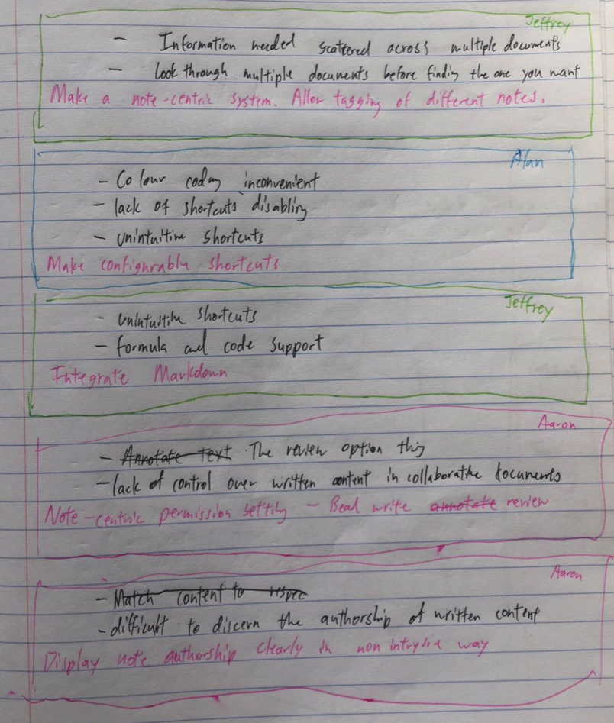
Low fidelity prototype
=

Slide 13
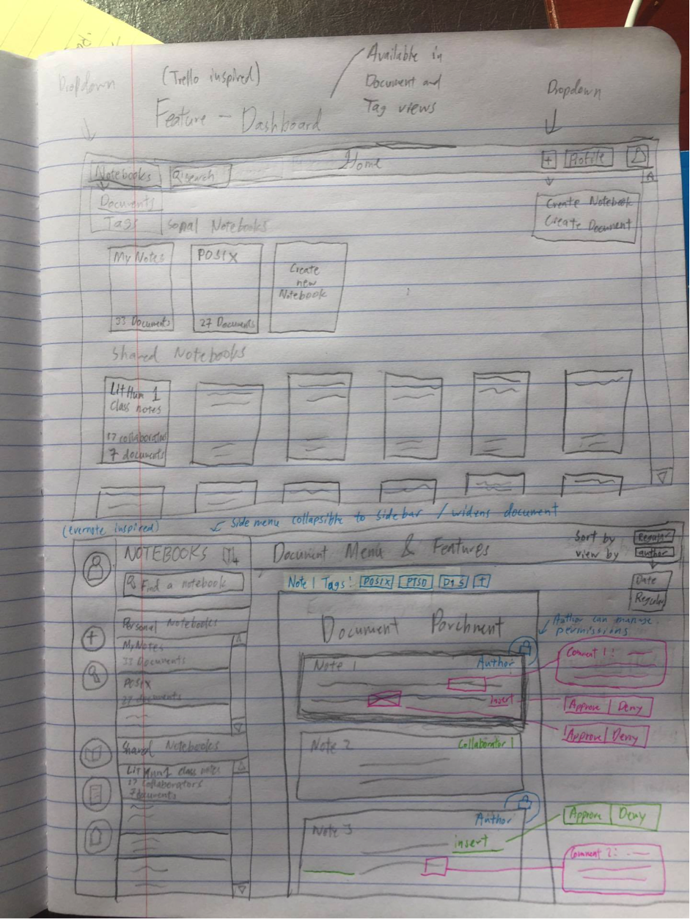
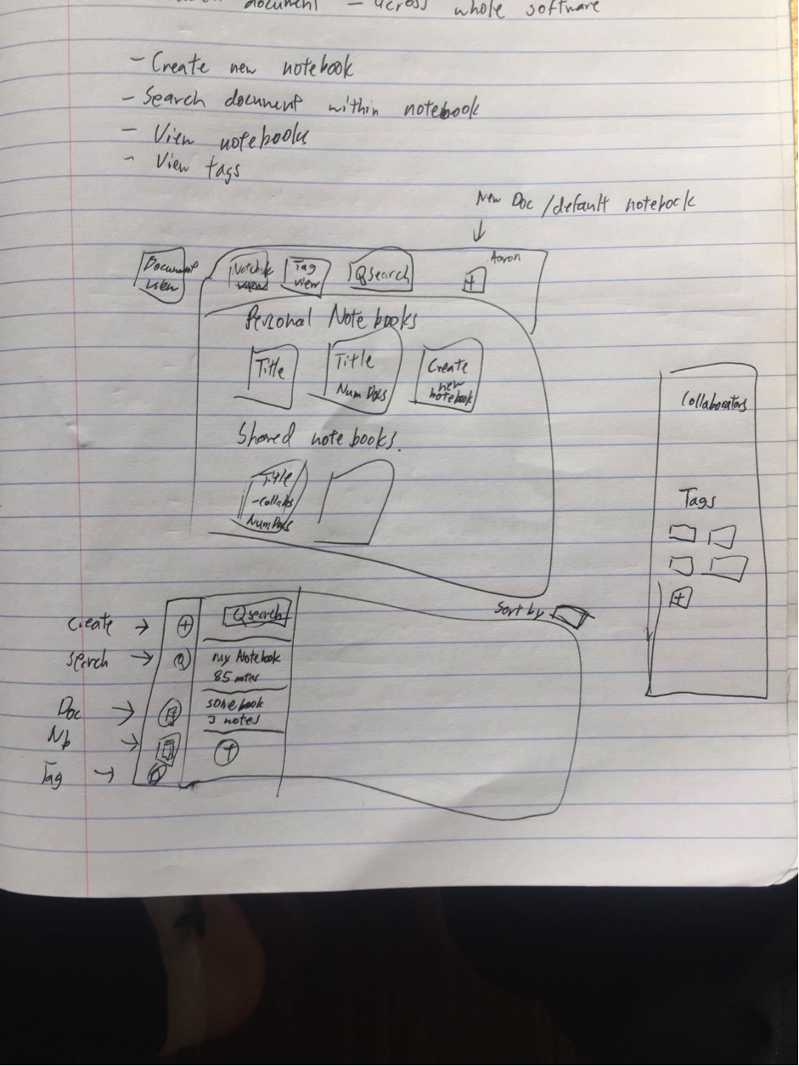
Low fidelity prototype

Slide 14
Evernote inspired editor

Slide 15
Trello inspired dashboard

Slide 16
Trello inspired dashboard

Slide 17
High Fidelity Prototype
DEMO TIME!!!

